Slide 1
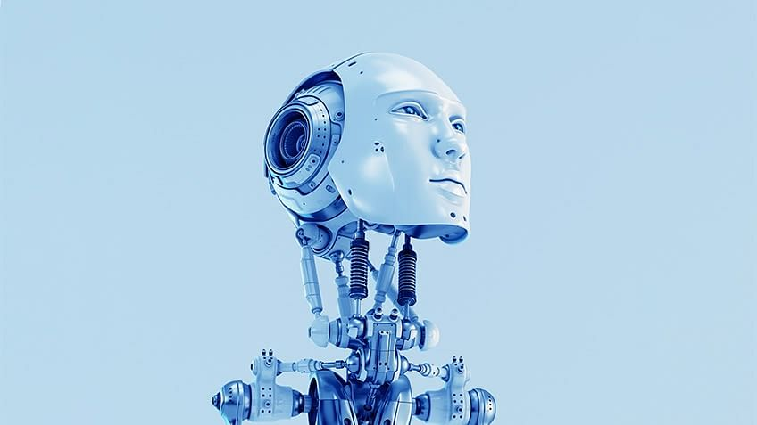
Introduction to Artificial Intelligence (AI)

Slide 2


Slide 3
Definition : AI
AI can be defined as the ability of a computer / machine to perform extremely complex tasks (that are associated with humans) with extreme proficiency
Why human intelligence ?
Ability to adjust with the change in environment
Humans have multiple traits / abilities
AI relies on the following features
Ability to learn
Ability to reason
Problem solving
Perception
Language

Slide 4





Types of Artificial Intelligence
Machine Learning
Natural Language Processing
Deep Learning
4

Slide 5























Where is AI used?
Predictive Analytics
Customer Experience
Real-time Operations Management
Supply Chain
Customer Services
Human Resources
Risk Management & Analytics
Fraud Detection
Customer Insight
Knowledge Creation
Pricing & Promotion
Research & Development

Slide 6
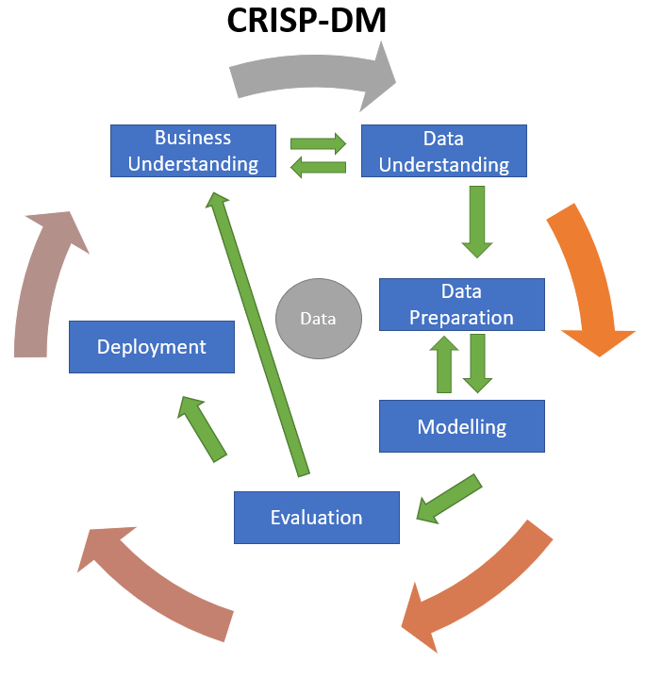
AI system lifecycle
CRISP-DM (CRoss-Industry Standard Process for Data Mining) is a widely used, six-phase methodology that provides a structured approach for planning and executing data science and analytics projects.

Slide 7
DEMO

Slide 9























Machine Learning
Machine Learning is the result of General AI that involves developing machines
that can deliver results like humans
Data
(Input)
Program
Traditional
Programming
Output
“Learning”
Machine
Learning System
Data
(Input)
Output
Input Data: Feed Learner Various Data
Output Data:
Present Rules
Machine
Learning
Program

Slide 10
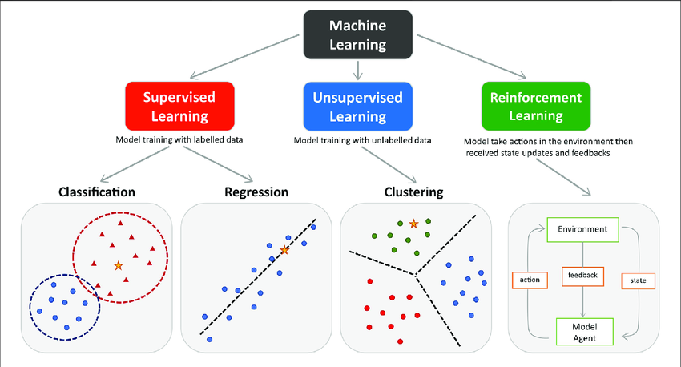
Type of Machine Learning

Slide 11
Examples of ML frameworks and algorithms
SCI-kit learn
Python library
Implementation of the most useful algorithms
Naïve Bayes, SVM, Random forests, decision trees…
Keras
Python library implementing about everything related to neural networks

Slide 12
















Machine Learning Life Cycle
Gathering Data
Preparing that Data
Choosing a Model
Training
Evaluation
Hyperparameter Tuning
Prediction

Slide 13









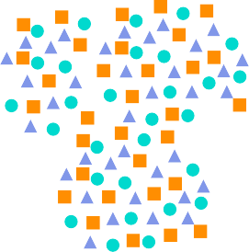


What is Supervised Machine Learning?
Supervised Learning
Supervisor
Training Data set
Desired Output
Output
Input Raw Data
Algorithm
Processing

Slide 14
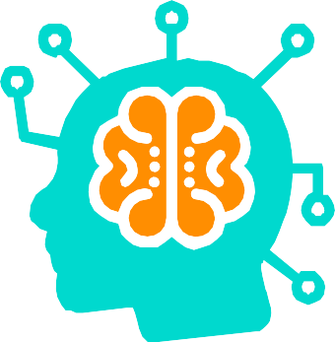













Types of Supervised Machine Learning Algorithms
Classification
Fraud Detection
Email Spam Detection
Diagnostics
Image Classification
Regression
Supervised Learning
Risk Assessment
Score Prediction

Slide 15













What is Unsupervised Learning?
Unsupervised Learning
Input Raw Data
Algorithm
Output
Unknown output
No Training Data Set
Interpretation
Processing

Slide 16






















Applications of Machine Learning
Automatic Language Translation
Image Recognition
Medical Diagnosis
Speech Recognition
Stock Market Trading
Traffic Prediction
Online Fraud Detection
Product Recommendations
Virtual Personal Assistant
Self Driving Cars
Email Spam and Malware Filtering

Slide 17
What Is NLP?
Artificial Intelligence
Computational Linguistics
NLP
It is automatic manipulation of speech or text
Goal ➔ To accomplish human-like language processing
The field of NLP involves making computers to perform useful tasks with the natural languages humans use. The input and output of an NLP system can be
Speech
Written Text

Slide 18

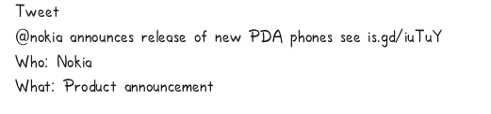
Why NLP?
CSK ➔ Computers lack knowledge
Large Volumes of Textual Data ➔There are at least 30 trillion pages➔70-80%
unstructured data i.e. raw text
Structuring a highly unstructured data source
Text Data-Website ,tweets , blog etc
Audio Data-Speech
Applications for processing large amount of data require NLP expertise

Slide 19
Basic Terms In NLP
Tokenization
It is the task of chopping up of string of characters into pieces, called tokens , perhaps at
the same time throwing away certain characters, such as punctuation.
Input: Friends, Romans, Countrymen, lend me your ears;
Output: Friends Romans Countrymen Lend me your ears
Stemming
Stemming is the process of eliminating affixes (suffixed, prefixes, infixes, circumfixes)
from a word in order to obtain a word stem.
running → run
Lemmatization
Lemmatization is related to stemming, differing in that lemmatization is able to capture
canonical forms based on a word's lemma.
Better → good

Slide 20
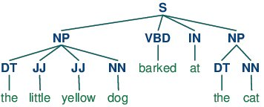
Corpus
Corpus refers to a collection of texts. Corpora may also consist of theme texts
(historical,Biblical, etc.). Corpora are generally solely used for statistical linguistic
analysis and hypothesis testing.
Stop Words
Stop words are those words which are filtered out before further processing of text
The quick brown fox jumps over the lazy dog.
Parts-of-speech (POS) Tagging
POS tagging consists of assigning a category tag to the tokenized parts of a
sentence. The most popular POS tagging would be identifying words as nouns,
verbs, adjectives, etc.

Slide 21
Approaches To NLP
Symbolic
Explicit depiction of facts about language through well understood schemes and algorithm
Deep Analysis of linguistic phenomena
Statistical
Uses mathematical techniques and large texts of corpora without incorporating world knowledge
Output produced by each state has a definitive probability
Connectionist
Combines statistical learning with various representation theories
Allows transformation,inference and logic formulae manipulation
Less Constrained Architecture

Slide 22
Components Of NLP
There are two components of NLP as given −
Natural Language Understanding (NLU)
Understanding involves the following tasks −
Mapping the given input in natural language into useful representations.
Analyzing different aspects of the language.
Natural Language Generation (NLG)
It is the process of producing meaningful phrases and sentences in the form of natural language from some internal representation . It involves
Text planning − It includes retrieving the relevant content from knowledge base.
Sentence planning − It includes choosing required words, forming meaningful phrases, setting tone of the sentence.
Text Realization − It is mapping sentence plan into sentence structure.
The NLU is harder than NLG.

Slide 23
Stages In NLP
Parsing
Phonology
Morphological
Translating
Syntactic
Semantic
Generating
Input
Discourse
Pragmatic
Lexical

Slide 24
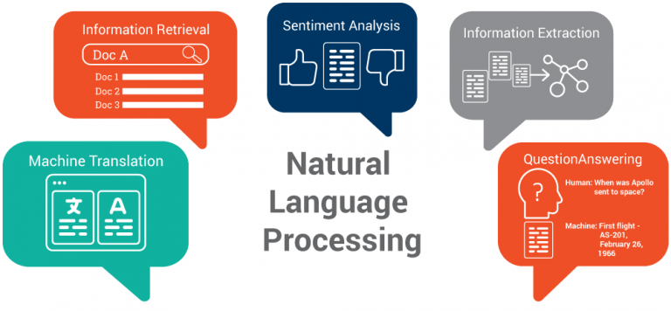
Some Applications Of NLP

Slide 25

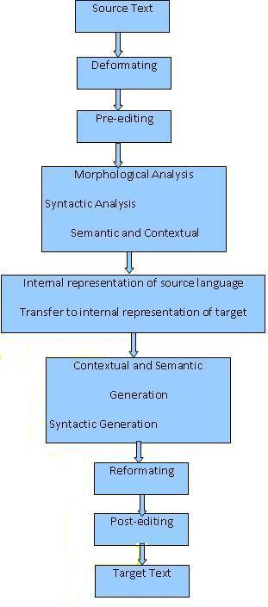
Machine Translation
Machine Translation (MT) is the task of automatically converting one natural language into another, preserving the meaning of the input text, and producing fluent text in the output language.
The human translation process may be described as:
Decoding the meaning of the source text
Re-encoding this meaning in the target language.
How to program a computer that will "understand" a text as a person
does, and that will "create" a new text in the target language that
sounds as if it has been written by a person?
➔Provide a general, though imperfect, approximation of the
original text, getting the "gist" of it (a process called "gisting").
This is sufficient for many purposes, including making best use of
the finite and expensive time of a human translator, reserved for those cases in
which total accuracy is indispensable.

Slide 26
Information Retrieval
The process of accessing and retrieving the most appropriate information from text based on a particular query using context-based indexing or metadata.
Simply, Information retrieval addresses the problem of finding those documents whose content matches a user's request from among a large collection of documents.
User i/p➔ Indian PM
Doc1➔Indian PM
Doc2➔Pakistan PM
Doc3➔American President
Brings document relating to Indian PM

Slide 27

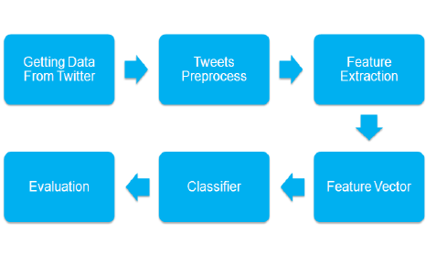
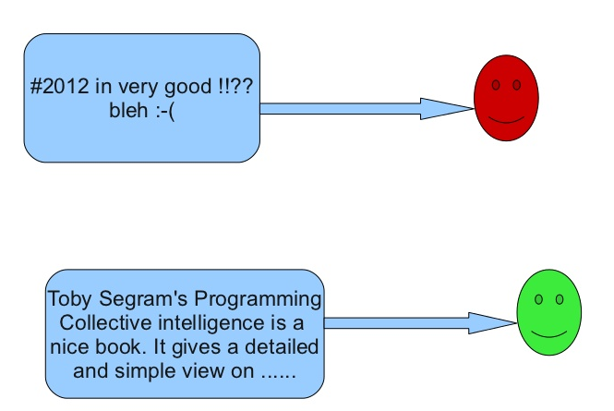
Sentiment Analysis
The process of evaluating and determining the sentiment captured in a selection of text
Sentiment defined as feeling or emotion.
This sentiment can be simply
positive (happy)
negative (sad or angry)
Neutral
precise measurement along a scale, with neutral in the middle, and positive and negative increasing in either direction.

Slide 28
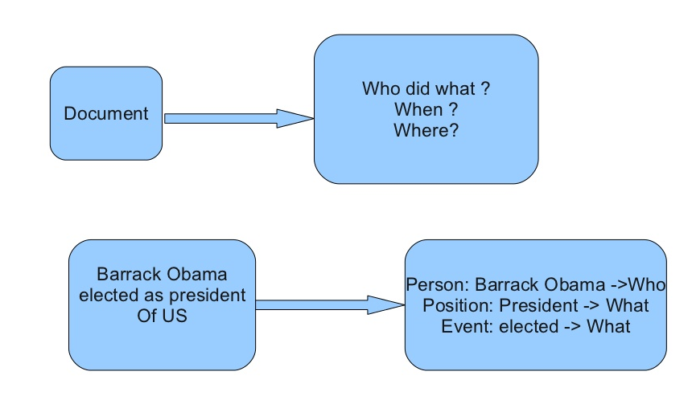
Information Extraction
Information extraction (IE) is the task of automatically extracting structured information from unstructured and/or semi-structured machine-readable documents.

Slide 29
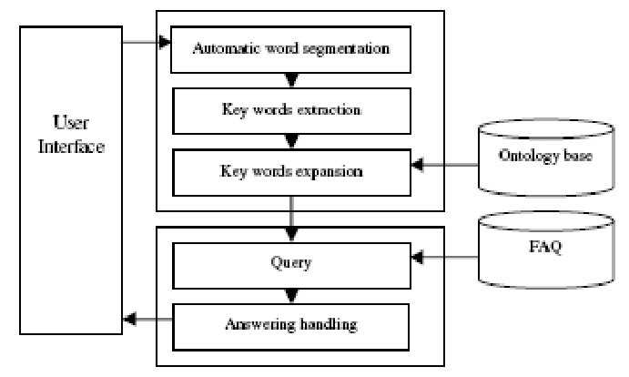
Question Answering
ELIZA-First Chatbot-developed by Joseph Weizenbaum
http://psych.fullerton.edu/mbirnbaum/psych101/Eliza.htm
Question-answering systems are referred to as intelligent systems that can be used to provide responses for the questions being asked by the user based on certain facts or rules stored in the knowledge base.
So the accuracy of a question-answering system to provide a correct response depends on the rules or facts stored in the knowledge base.

Slide 30




















Deep Learning
Deep Learning is a subfield of machine learning that is concerned with algorithms inspired by the brain's structure
&
functions known as artificial neural
networks
A computer model can be taught using Deep Learning to run classification actions using pictures, texts or sounds as input

Slide 31

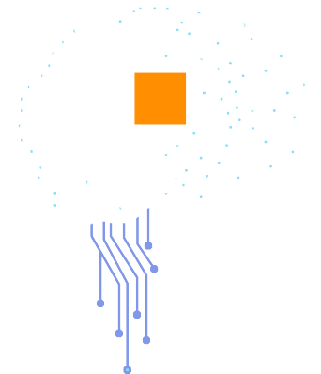










What is Deep Learning?
Deep Learning is a subfield of machine learning that is concerned with algorithms inspired by the brain's structure and functions known as artificial neural networks.
A computer model can be taught using Deep Learning to run classification actions using pictures, texts or sounds as input.
What is Deep Learning?
Car Not Car
Input
Feature Extraction + Classification
Output

Slide 32
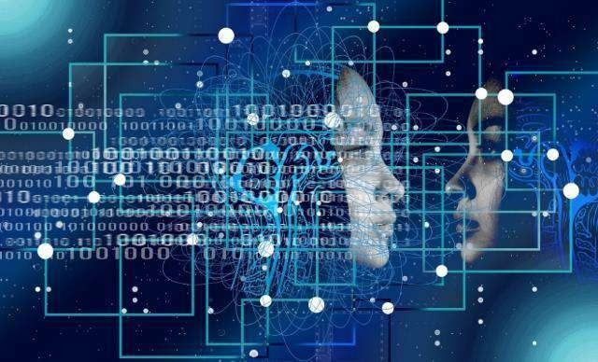





























Types of Deep Learning Networks
Supervised | Artificial Neural Networks Convolutional Neural Networks Recurrent Neutral Networks | Used for Regression & Classification Used for Computer Vision Used for Time Series Analysis
Unsupervised | Self-Organizing Maps Deep Boltzmann Machines AutoEncoders | Used for Feature Detection Used for Recommendation Systems Used for Recommendation Systems
Supervised
Unsupervised
o Artificial Neural Networks (ANN)
o Self Organizing Maps (SOM)
Deep Learning Models
o Convolutional Neural Networks (CNN)
o Boltzmann Machines (BM)
o Recurrent Neural Networks (RNN)
o AutoEncoders (AE)

Slide 33


















Examples of Deep Learning Applications
Drug Discovery & Better Diagnostics of Diseases in Healthcare
Natural Language
Processing
Robots and Self
- Driving Cars
Image
Recognition
Portfolio Management & Prediction of Stock Price Movements
Speech
Recognition

Slide 34


Limitations of Deep Learning
Interpretability
Limitations of Deep Learning
Amount of Data
Statistical Reasoning

Slide 35
































Reinforcement Learning
Action
Exploration Policy
Neural Networks
Filters
Memory
Algorithm
Reinforcement Learning
uses rewards and punishment to train computing models to perform a sequence of selections. Here computing faces a game-like scenario where
it employs trial and error to answer. Based on the action it performs, computing gets either rewards or penalties. Its goal is to maximize the rewards.
Agent
Environment
State, Reward

Slide 36
























What is Reinforcement Learning?
Reinforced Response
It’s a
mango
Wrong! It’s an apple
It’s an
Apple
Noted
Input
Response
Feedback
Learns
Input

Slide 37













Types of Reinforcement Learning
Gaming
Robot Navigation
Finance Sector
Inventory Management
Manufacturing

Slide 38












How Reinforcement Learning Works?
Reinforcement Learning
Input Raw Data
Environment
Output
Reward
Best Action
State
Selection of Algorithm
Agent

Slide 39



































AI VS Machine Learning VS Deep Learning
o Artificial Intelligence originated around
1950s
o Machine Learning originated around
1960s
o Deep Learning originated around 1970s
o Deep Learning is the process of using artificial neural networks to solve complex problems
o AI represents simulate intelligence in machines
o Machine learning is the practice of getting machines to make decisions without being programmed
o AI is a subset of data science
o Deep Learning is a subset of Machine Learning, AI & Data Science
o Machine learning is a subset of AI & Data Science
o Aim is to build machines which are capable of thinking like humans
o Aim is to build neural networks that au6tonetically discover patterns for feature detection
o Aim is to make machines learn through
data so that they can solve problems
Artificial Intelligence
Machine Learning
Deep Learning

Slide 40
THANK YOU !

